Slide 1

ROUTING
AND
ADDRESSING
prepared by: Khoi Nguyen
presented date: Dec 24, 2008

Slide 2
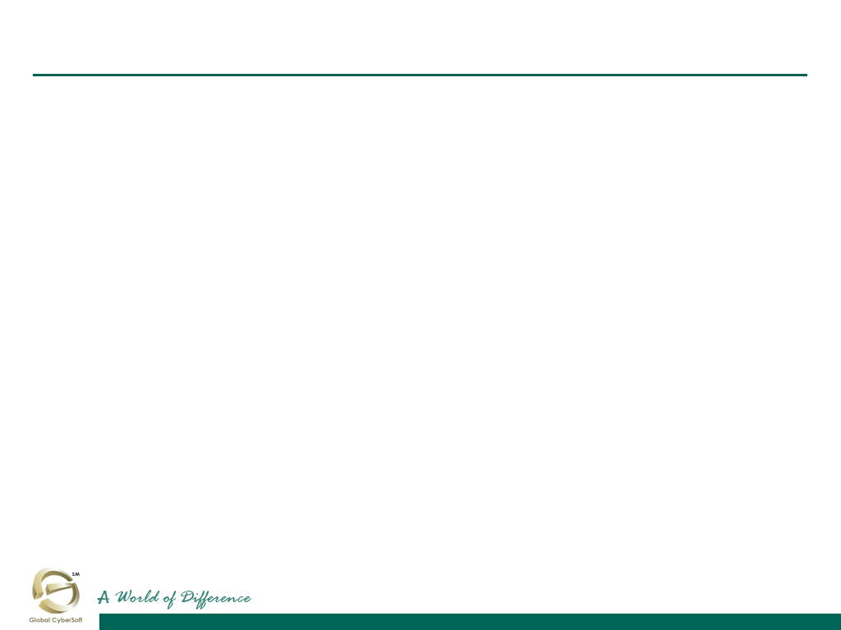
Objective
Learn about the router’s use and operations in performing the key internetworking function of the Open System Interconnection (OSI) reference model’s network layer, Layer 3.
Learn about IP addressing and the three classes of networks in IP addressing schemes.
Learn that some IP addresses have been set aside by the ARIN and cannot be assigned to any network.
Learn about subnetworks and subnet masks and their IP addressing schemes.

Slide 3
NETWORK LAYER
AND
PATH DETERMINATION

Slide 4
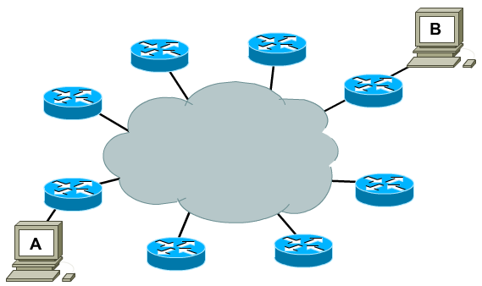
A network layer. Why?

Slide 5
Network layer
Segment network and control flow of traffic.
Logical Addressing, use a hierarchical addressing scheme.

Slide 6
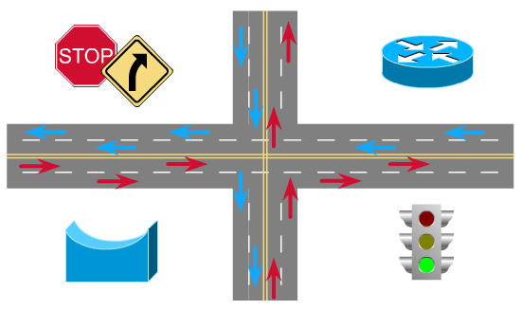
Network segmentation. Why?

Slide 7
Network segmentation
Control network traffics and reduce broadcast traffics.
Separate computer networks is managed by a single administration - Autonomous systems.

Slide 8
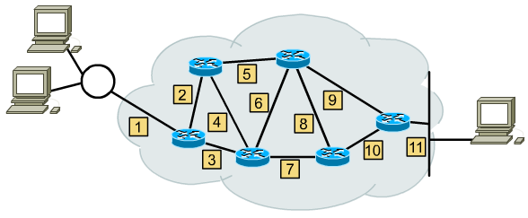
Communication among networks
Networks operate in much the same manner.

Slide 9
Router
Routers connect separate networks.
Routers make best path decisions based on Layer 3 information.
Routers actually switch packets from incoming ports to appropriate outgoing ports.

Slide 10
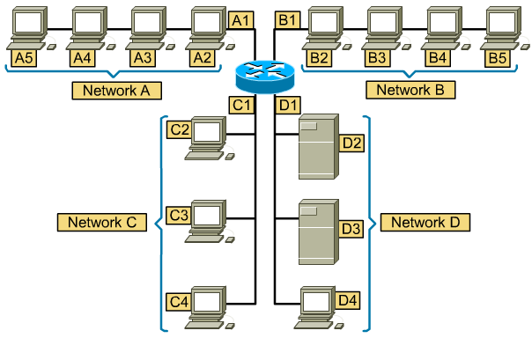
Data relaying

Slide 11
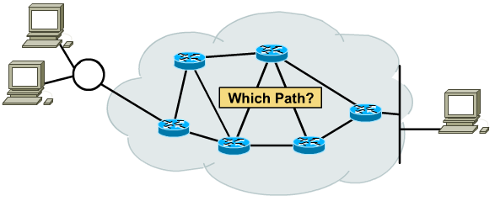
Path determination
Path determination is the process that the router uses to choose the next hop in the path for the packet to travel to its destination based on the link bandwidth, hop, delay ...

Slide 12
Network address
The network address helps the router identify a path within the network cloud.
The router uses the network address to identify the destination network of a packet within an internetwork.
Network address is assigned by higher-level administrator. Host address is assigned manually or automatically by manager of that network.

Slide 13
IP ADDRESS CLASSES

Slide 14
IP network address
Network layer addresses are 32 bits long.
The are presented as four octets in dotted decimal format.
The IP address has two components: Network ID and Host ID.

Slide 15

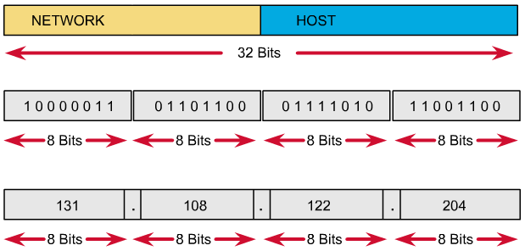
IP address format

Slide 16
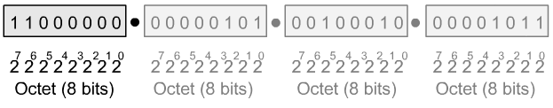
Binary and decimal conversion

Slide 17
Why we need to know B-D conversion
Use of calculators is discouraged for two reasons :
  First, practitioners of networking often need to make quick.
  Second, no calculators are allowed on the CCNA exam.

Slide 18
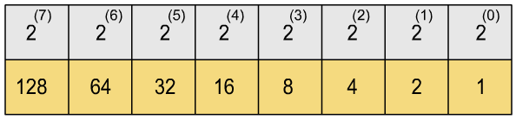
Fast conversion

Slide 19
Exercise: DEC – BIN
203
11001011

Slide 20
Exercise: BIN – DEC
10100010
162

Slide 21
Network ID and host ID
Network ID :
  Assigned by Internet Network Information Center.
  Assigned by upper organization.
  Identifies the network to which a devices is attached.
Host ID :
  Assigned by a network administrator.
  Identifies the specific device on that network.

Slide 22
Bits on the IP address
Network Bits :
  Identifies network ID
  Identifies class of the IP address
  All of bits are 0: not allowed
Host Bits :
  Identifies host ID
  All of bits are 0: reserved for network address
  All of bits are 1: reserved for broadcast address

Slide 23
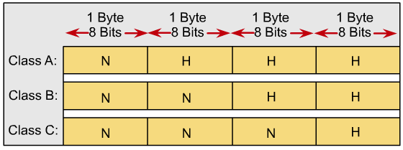
IP address classes
Different class addresses reserve different amounts of bits for the Network and Host portions of the address
Provide the flexibility required to support different size networks

Slide 24
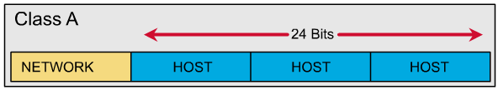
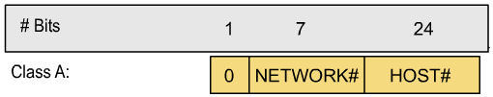
IP address classes: Class A

Slide 25
IP address classes: Class A
The first bit of a Class A address is always 0.
The first 8 bits to identify the network part of the address.
Possible network address from 1.0.0.0 to 127.0.0.0.
The remaining three octets can be used for the host portion of the address.
Each class A network have up to 16,777,214 possible IP addresses.

Slide 26
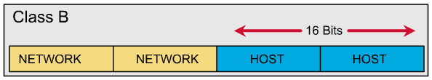

IP address classes: Class B

Slide 27
IP address classes: Class B
The first 2 bits of a Class B address is always 10.
The first two octets to identify the network part of the address.
Possible network address from 128.0.0.0 to 191.255.0.0.
The remaining two octets can be used for the host portion of the address.
Class B network have up to 65.534 possible IP addresses.

Slide 28
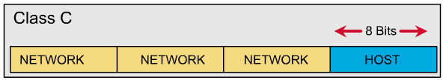
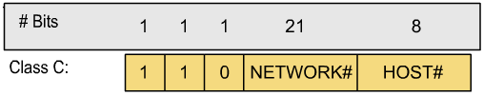
IP address classes: Class C

Slide 29
IP address classes: Class C
The first 3 bits of a Class C address is always 110.
The first three octets to identify the network part of the address.
Possible network address from 192.0.0.0 to 223.255.255.0.
The remaining last octet can be used for the host portion of the address.
Class C network have up to 254 possible IP addresses.

Slide 30
IP address classes: Summary
1.0.0.0 - 126.0.0.0 : Class A.
127.0.0.0 : Loopback network.
128.0.0.0 - 191.255.0.0 : Class B.
192.0.0.0 - 223.255.255.0 : Class C.
224.0.0.0 < 240.0.0.0 : Class D, multicast.
>= 240.0.0.0 : Class E, reserved.

Slide 31
Network address
Network address provide a convenient way to refer to all of the addresses on a particular network or subnetwork.
Two hosts with differing network address require a device, typically a router, in order to communicate.
An IP address that ends with binary 0s in all host bits is reserved for the network address.

Slide 32
Broadcast address
Broadcast goes to every host with a particular network ID number.
An IP address that ends with binary 1s in all host bits is reserved for the directed broadcast address.
An IP address with binary 1s in all network bits and host bits is reserved for the local broadcast address.

Slide 33
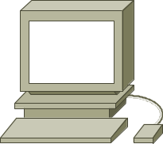

Local broadcast address
STOP
255.255.255.255

Slide 34
Directed broadcast address
192.168.20.0
192.168.20.255
Broadcast address

Slide 35
Example: 172.16.20.200
172.16.20.200 is Class B address
Network portion: 172.16
Host portion: 20.200
Network address: 172.16.0.0
Broadcast address: 172.16.255.255

Slide 36
Private addresses
According to RFC-1918.
Organizations make use of the private Internet address space for hosts that require IP connectivity within their enterprise network, but do not require external connections to the global Internet.
Class A: 10.0.0.0.
Class B: 172.16.0.0 - 172.31.0.0.
Class C: 192.168.0.0 - 192.168.255.255.

Slide 37
Lab 10.4.1: Step 2
What is the decimal and binary range of the first octet of class B IP addresses?
  Decimal: 128 – 191
  Binary: 10000000 – 10111111
Which octet(s) represent the network portion of a class C IP address?
  The first three octets
Which octet(s) represent the host portion of a class A IP address?
  The last three octets

Slide 38
Lab 10.4.1: Step 3
Host IP Address | Address Class | Network Address | Host Address | Broadcast Address
218.14.55.137
123.1.1.15
150.127.221.244
194.125.35.199
175.12.239.244
C
218.14.55
137
218.14.55.255
A
123
1.1.15
123.255.255.255
B
150.127
221.244
150.127.255.255
C
194.125.35
199
194.125.35.255
B
175.12
239.244
175.12.255.255

Slide 39
Lab 10.4.1: Step 4 – Valid address
150.100.255.255
175.100.255.18
195.234.253.0
100.0.0.23
188.258.221.176
127.34.25.189
224.156.217.73

Slide 40
SUBNETTING
AND
CREATING A SUBNET

Slide 41
Why we need to divide network?
Network administrators sometimes need to divide networks, especially large ones, into smaller networks:
  Reduce the size of a broadcast domain.
  Improve network security.
  Implement the hierarchical managements.
So we need more network addresses for your network. But I want the outside networks see our network as a single network.

Slide 42
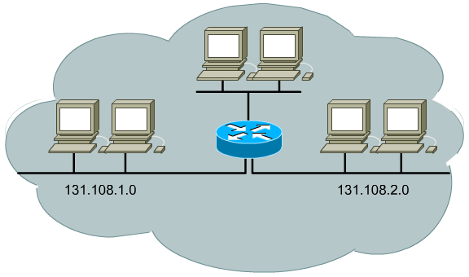
Divide network by three

Slide 43
Subnetting
Subnetworks are smaller divisions of network.
Subnet addresses include the Class A, Class B, or Class C network portion, plus a subnet field and a host field.
To create a subnet address, a network administrator borrows bits from the original host portion and designates them as the subnet field.
Subnet addresses are assigned locally, usually by a network administrator.

Slide 44
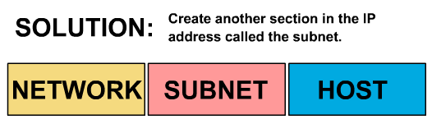
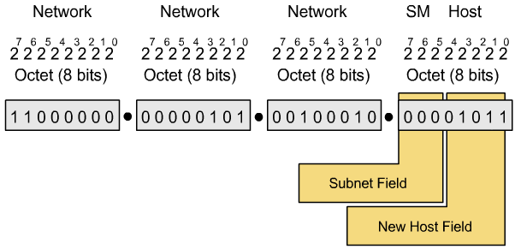
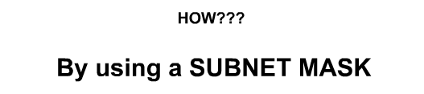
Subnetting

Slide 45
Subnet mask
“Extended Network Prefix”.
Determines which part of an IP address is the network field and which part is the host field.
32 bits long.
Divided into four octets.
Network and Subnet portions all 1’s.
Host portions all 0’s.

Slide 46
Default subnet mask: Example
192.168.2.100 / 255.255.255.0.
11000000.10101000.00000010.01100100.
11111111.11111111.11111111.00000000.
11000000.10101000.00000010.01100100.
Class C network:
  24 bits for network portion.
  0 bits for subnet portion.
  8 bits for host portion.
Subnet address: 192.168.2.0.

Slide 47
Subnet mask: Example
172.16.65.100 / 255.255.240.0.
10101100.00010000.01000001.01100100.
11111111.11111111.11110000.00000000.
10101100.00010000.01000001.01100100.
Class B network:
  16 bits for network portion.
  4 bits for subnet portion.
  12 bits for host portion.
Subnet address: 172.16.64.0.

Slide 48
How many bits can I borrow?
All of subnet bits are:
  0 : reserved for network address.
  1 : reserved for broadcast address.
The minimum bits you can borrow is:
2 bits.
The maximum bits you can borrow is:
A: 22 bits ~ 2²² - 2 = 4.194.302 subnets.
B: 14 bits ~ 2¹⁴ - 2 = 16.382 subnets.
C: 06 bits ~ 2⁰⁶ - 2 = 62 subnets.

Slide 49
Boolean algebra review
Boolean operators:
  AND.
  OR.
  NOT.

Slide 50
AND operator
1 AND 1 = 1
1 AND 0 = 0
0 AND 1 = 0
0 AND 0 = 0

Slide 51
OR operator
1 OR 1 = 1
1 OR 0 = 1
0 OR 1 = 1
0 OR 0 = 0

Slide 52
NOT operator
NOT 1 = 0
NOT 0 = 1

Slide 53
Boolean algebra examples
1010 AND 0110 = 0010
1010 OR 0110 = 1110

Slide 54
Why we need to know Boolean ops?
IP Address
Subnet Mask
Network and Subnet address
AND
=
Network layer performs the Boolean operations in order to find the network ID of a subnet
Example:
  172.16.65.100 AND 255.255.240.0
  Network address: 172.16.64.0

Slide 55
Subnetting example
Given network 172.16.0.0.
We need 8 usable subnets and up to 1000 hosts on each subnet.

Slide 56
Calculating a subnet
Determine the class of network and default subnet mask.
Determine how many bits to borrow. Determine the subnet mask and the actual number of subnets and hosts.
Determine the ranges of host address for each subnet. Choose the subnets that you want to use.

Slide 57
Calculating a subnet: STEP 1
Determine the Class of network
Class B
Determine the default subnet mask
255.255.0.0

Slide 58
Calculating a subnet: STEP 2
Number of subnets <= 2^{n} - 2 with n is number of bits that are borrowed.
Number of hosts <= 2^{m} - 2 with m is number of bits that are remained.
Determine how many bits to borrow from the host portion from requirement:
  8 subnets.
  1000 hosts on each subnet.

Slide 59
Calculating a subnet: STEP 2 (Cont.)
Choose n = 4:
  Number of possible subnets is:
    2⁴ - 2 = 14
  Number of possible hosts on each subnet is:
    2⁽¹⁶⁻⁴⁾ - 2 = 4094
Other choice n = 5 , n = 6 ?

Slide 60
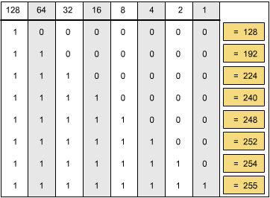
Calculating a subnet: STEP 2 (Cont.)
The subnet mask: 255.255.240.0.

Slide 61
Calculating a subnet: STEP 3
Determine the subnets and the ranges of host address for each subnet. Including:
Sub-network addresses
Range of usable IP addresses
Sub-network broadcast addresses

Slide 62
Calculating a subnet: STEP 3 (Cont.)
Determine the subnets from 4 borrowed bits from the host portion (last 2 bytes):
1st subnet: .00000000.00000000
2nd subnet: .00010000.00000000
3rd subnet: .00100000.00000000
…
15th subnet: .11110000.00000000

Slide 63
Calculating a subnet: STEP 3 (Cont.)
No | Sub-network address | Possible host address | Broadcast address | Use?
0 | 172.16.0.0 | 172.16.0.1 – 172.16.15.254 | 172.16.15.255 | N
1 | 172.16.16.0 | 172.16.16.1 – 172.16.31.254 | 172.16.31.255 | Y
2 | 172.16.32.0 | 172.16.32.1 – 172.16.47.254 | 172.16.47.255 | Y
.. | .. | .. | .. | ..
.. | .. | .. | .. | ..
13 | 172.16.208.0 | 172.16.208.1 – 172.16.223.254 | 172.16.223.255 | Y
14 | 172.16.224.0 | 172.16.224.1 – 172.16.239.254 | 172.16.239.255 | Y
15 | 172.16.240.0 | 172.16.240.1 – 172.16.255.254 | 172.16.255.255 | N

Slide 64
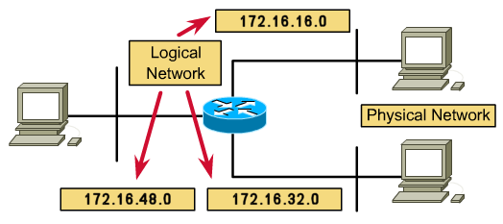
Calculating a subnet: STEP 3 (Cont.)
Using subnets No.1 to No.8.
Assign IP addresses to hosts and interfaces on each network. IP address configuration.

Slide 65
Thank you
Thanks for your attention!

